Slide 1
Characterizing the current state of a propulsion engine: A comparison of machine learning frameworks
S. Sehgal, C. Cheung, and J. Valdes
May 14th, 2019
Canadian Aeronautics and Space Institute – AERO19
Notes:
My name is Srishti.
I am a full time undergraduate from the University of Toronto currently on co-op at the National Research Council in Ottawa.
Today I have the pleasure of presenting the recent work that my team and I have done for one of our research projects.
Firstly I would like to thank the organizers of this conference for this wonderful event. I would like to the ask the audience if they can hear me well before I fully start.

Slide 2
Motivation
Machine learning models are being used in several fields like structural health monitoring.
Large feature sets can lead to problems in accuracy and performance.
Developed models to distinguish between healthy and failed system states for an engine.
Is there a way to make them even more robust?

Slide 3
Introduction
For many complex systems, distribution of failed to healthy states is skewed as failed events are not common.
In this work, we are proposing a new framework to distinguish between normal healthy operating conditions and failed system states.
Reduce dimensions (features) of the dataset
Train with multiple loss functions and
Evaluate and compare this framework with a simpler model

Slide 4
Introduction
Sample Features
Turbocharger failure among other types of failures were recorded by sensor system
100s of sensor readings available
Can develop strategies to extract useful and intuitive information
Establish indicators of system health to distinguish between healthy and failed states
Can optimize operations (avoid interruptions in service, help understand where efforts need to spent during maintenance and reduce cost/improve R&D)
1 | Turbo A Speed
2 | Turbo B Speed
3 | Charge air manifold pressure
… | …
25 | Turbocharger A inlet temp.
26 | Turbocharger B outlet temp.
27 | Turbocharger A outlet temp.
28 | Exhaust gas temp. cyl. A1
… | …
51 | Exhaust gas temp. cyl. B10
Data-driven model building
Engine
Pressure in quadrant A
is increasing steadily,
likely to fail within 300 miles
Model
Predictions
Decision support system

Slide 5
Motivation and Introduction
Background
Neural Network
Auto-encoders
Metrics for Evaluation
Multi-task Learning
Experimental Setup – Models
Data Distribution
Classification Results
Discriminative Analysis
Summary and Future Steps

Slide 6
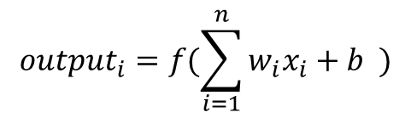
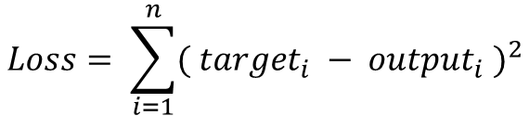
Background- Neural Network
features
w₁
w₂
w₃
x_{0, 1} | x_{1, 1} | x_{2, 1}
x_{0, 2} | x_{1, 2} | x_{2, 2}
samples
input matrix
weight matrix
x₁
$${output}_{i}=f(\sum_{i=1}^{n}{w_{i}x_{i}}+b )$$
w₁
…
output
$$Loss= \sum_{i=1}^{n}{{( {target}_{i} − {output}_{i} )}^{2}}$$
x_{n}
w_{n}

Slide 7
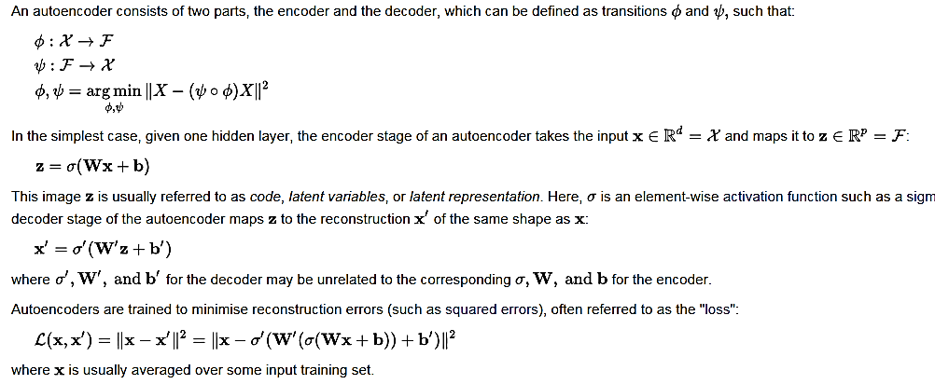
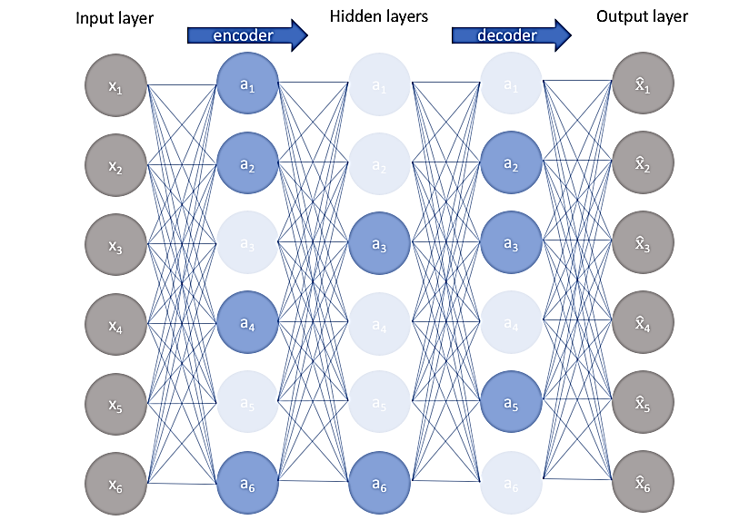
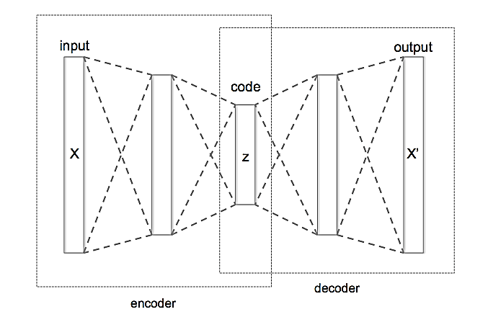
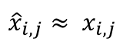
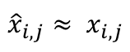
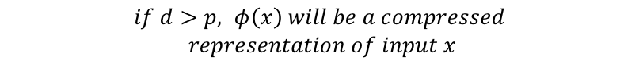
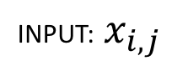
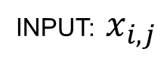
Background – Auto-encoder and sparsity
Dataset within
auto-encoder:
input
*Less model capacity, but
same accuracy
latent
dataspace
An auto-encoder recreates the input dataset (model output = input)
It can create a compressed version of dataset constructed from the original dataset
The compressed dataset will have the same number of datapoints but less variables/features
output
$$if d>p, _φ\left(x\right) will be a compressed$$
$$representation of input x$$
Dense auto-encoder:
Sparse auto-encoder*:
INPUT: $x_{i,j}$
INPUT: $x_{i,j}$
compressed
dataspace
OUTPUT:
OUTPUT:
$${\hat{x}}_{i,j}≈ x_{i, j}$$
*Less model capacity, but
same accuracy
$${\hat{x}}_{i,j}≈ x_{i, j}$$
Notes:
An autoencoder is a type of model that is able to recreate the input. The identity function would be the trivial solution, but by placing constraints on the network, one can extract interesting structures in the dataset. For instance, by restricting the number of features to be less than the original, the network is compelled to learn a compressed representation of the input. It’s a simple way to automatically learn and engineer features from an unlabeled dataset . Some benefits include the potential to be invariant to small changes in the input (possible noise) and hence robust, and the ability for creating representations that are more linearly separable.
Suppose you purchased a robot and you want to teach him to classify Japanese characters. The first 2 characters belong to the first category, the next 2 are the second category. Unfortunately, the robot is too smart for the task. It has large enough memory to remember 2 characters. After memorizing the first two, as long as a character is not one of those 2, the robot will put the character into the second category.
This character should belong to the first category. Based on its algorithm, the robot will put this character into the second category, which is wrong. The robot failed the task because it’s too smart and the training data is too small. This is the problem of over-fitting. How can sparsity avoid over-fitting?
A little upset at your robot, you turn it off and go to put it back on its shelf. But you dropped your robot. You pick it up and shake it a little and hear a rattling noise inside…oops I it’s probably broken a little inside! So to test it, you decide to give it the same learning task again. You let the robot do the training again and still force him to achieve the same accuracy. Because he can’t remember all 2 characters this time, you essentially force him to look for a simpler pattern. Now he discovers the common part of all the first category of characters!
So instead of simply memorizing stuff, it has to look for simpler patterns from the data. In summary, the sparsity constraint helps the model find simpler patterns in the data without being super dependent on the values of the nodes around it.
Forcing too much sparsity, however, can hurt predictive performance because it reduces the overall effective capacity of the model

Slide 8
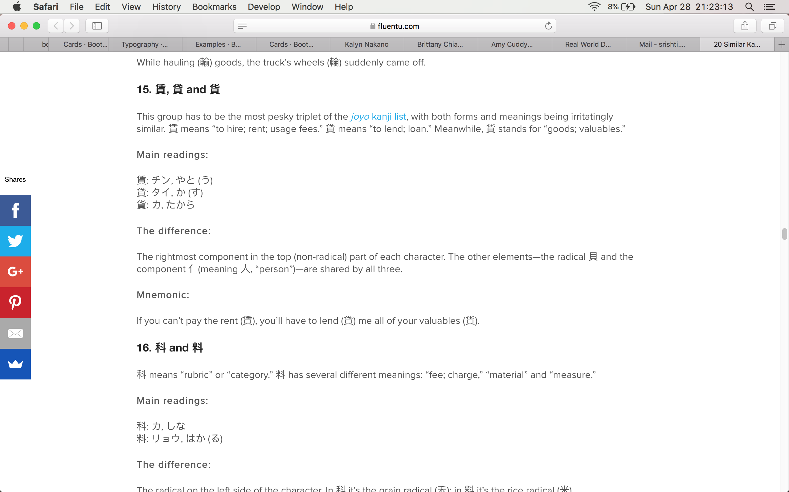

Background – Auto-encoder and sparsity
Training Set
Testing Set
Target: Class 1
Target: Class 1
Target: Class 2
Target: Class 2
Target: Class 1
Prediction: Class 2
Overfitting is a problem that many models need to avoid
Sparsity can help models find simpler patterns in the data
Notes:
An autoencoder is a type of model that is able to recreate the input. The identity function would be the trivial solution, but by placing constraints on the network, one can extract interesting structures in the dataset. For instance, by restricting the number of features to be less than the original, the network is compelled to learn a compressed representation of the input. It’s a simple way to automatically learn and engineer features from an unlabeled dataset . Some benefits include the potential to be invariant to small changes in the input (possible noise) and hence robust, and the ability for creating representations that are more linearly separable.
Suppose you purchased a robot and you want to teach him to classify Japanese characters. The first 2 characters belong to the first category, the next 2 are the second category. Unfortunately, the robot is too smart for the task. It has large enough memory to remember 2 characters. After memorizing the first two, as long as a character is not one of those 2, the robot will put the character into the second category.
This character should belong to the first category. Based on its algorithm, the robot will put this character into the second category, which is wrong. The robot failed the task because it’s too smart and the training data is too small. This is the problem of over-fitting. How can sparsity avoid over-fitting?
A little upset at your robot, you turn it off and go to put it back on its shelf. But you dropped your robot. You pick it up and shake it a little and hear a rattling noise inside…oops I it’s probably broken a little inside! So to test it, you decide to give it the same learning task again. You let the robot do the training again and still force him to achieve the same accuracy. Because he can’t remember all 2 characters this time, you essentially force him to look for a simpler pattern. Now he discovers the common part of all the first category of characters!
So instead of simply memorizing stuff, it has to look for simpler patterns from the data. In summary, the sparsity constraint helps the model find simpler patterns in the data without being super dependent on the values of the nodes around it.
Forcing too much sparsity, however, can hurt predictive performance because it reduces the overall effective capacity of the model

Slide 9
Background – Auto-encoder and sparsity
Training Set
Testing Set
Target: Class 1
Target: Class 1
Target: Class 2
Target: Class 2
Target: Class 1
Prediction: Class 1
Overfitting is a problem that many models need to avoid
Sparsity can help models find simpler patterns in the data
Notes:
An autoencoder is a type of model that is able to recreate the input. The identity function would be the trivial solution, but by placing constraints on the network, one can extract interesting structures in the dataset. For instance, by restricting the number of features to be less than the original, the network is compelled to learn a compressed representation of the input. It’s a simple way to automatically learn and engineer features from an unlabeled dataset . Some benefits include the potential to be invariant to small changes in the input (possible noise) and hence robust, and the ability for creating representations that are more linearly separable.
Suppose you purchased a robot and you want to teach him to classify Japanese characters. The first 2 characters belong to the first category, the next 2 are the second category. Unfortunately, the robot is too smart for the task. It has large enough memory to remember 2 characters. After memorizing the first two, as long as a character is not one of those 2, the robot will put the character into the second category.
This character should belong to the first category. Based on its algorithm, the robot will put this character into the second category, which is wrong. The robot failed the task because it’s too smart and the training data is too small. This is the problem of over-fitting. How can sparsity avoid over-fitting?
A little upset at your robot, you turn it off and go to put it back on its shelf. But you dropped your robot. You pick it up and shake it a little and hear a rattling noise inside…oops I it’s probably broken a little inside! So to test it, you decide to give it the same learning task again. You let the robot do the training again and still force him to achieve the same accuracy. Because he can’t remember all 2 characters this time, you essentially force him to look for a simpler pattern. Now he discovers the common part of all the first category of characters!
So instead of simply memorizing stuff, it has to look for simpler patterns from the data. In summary, the sparsity constraint helps the model find simpler patterns in the data without being super dependent on the values of the nodes around it.
Forcing too much sparsity, however, can hurt predictive performance because it reduces the overall effective capacity of the model

Slide 10
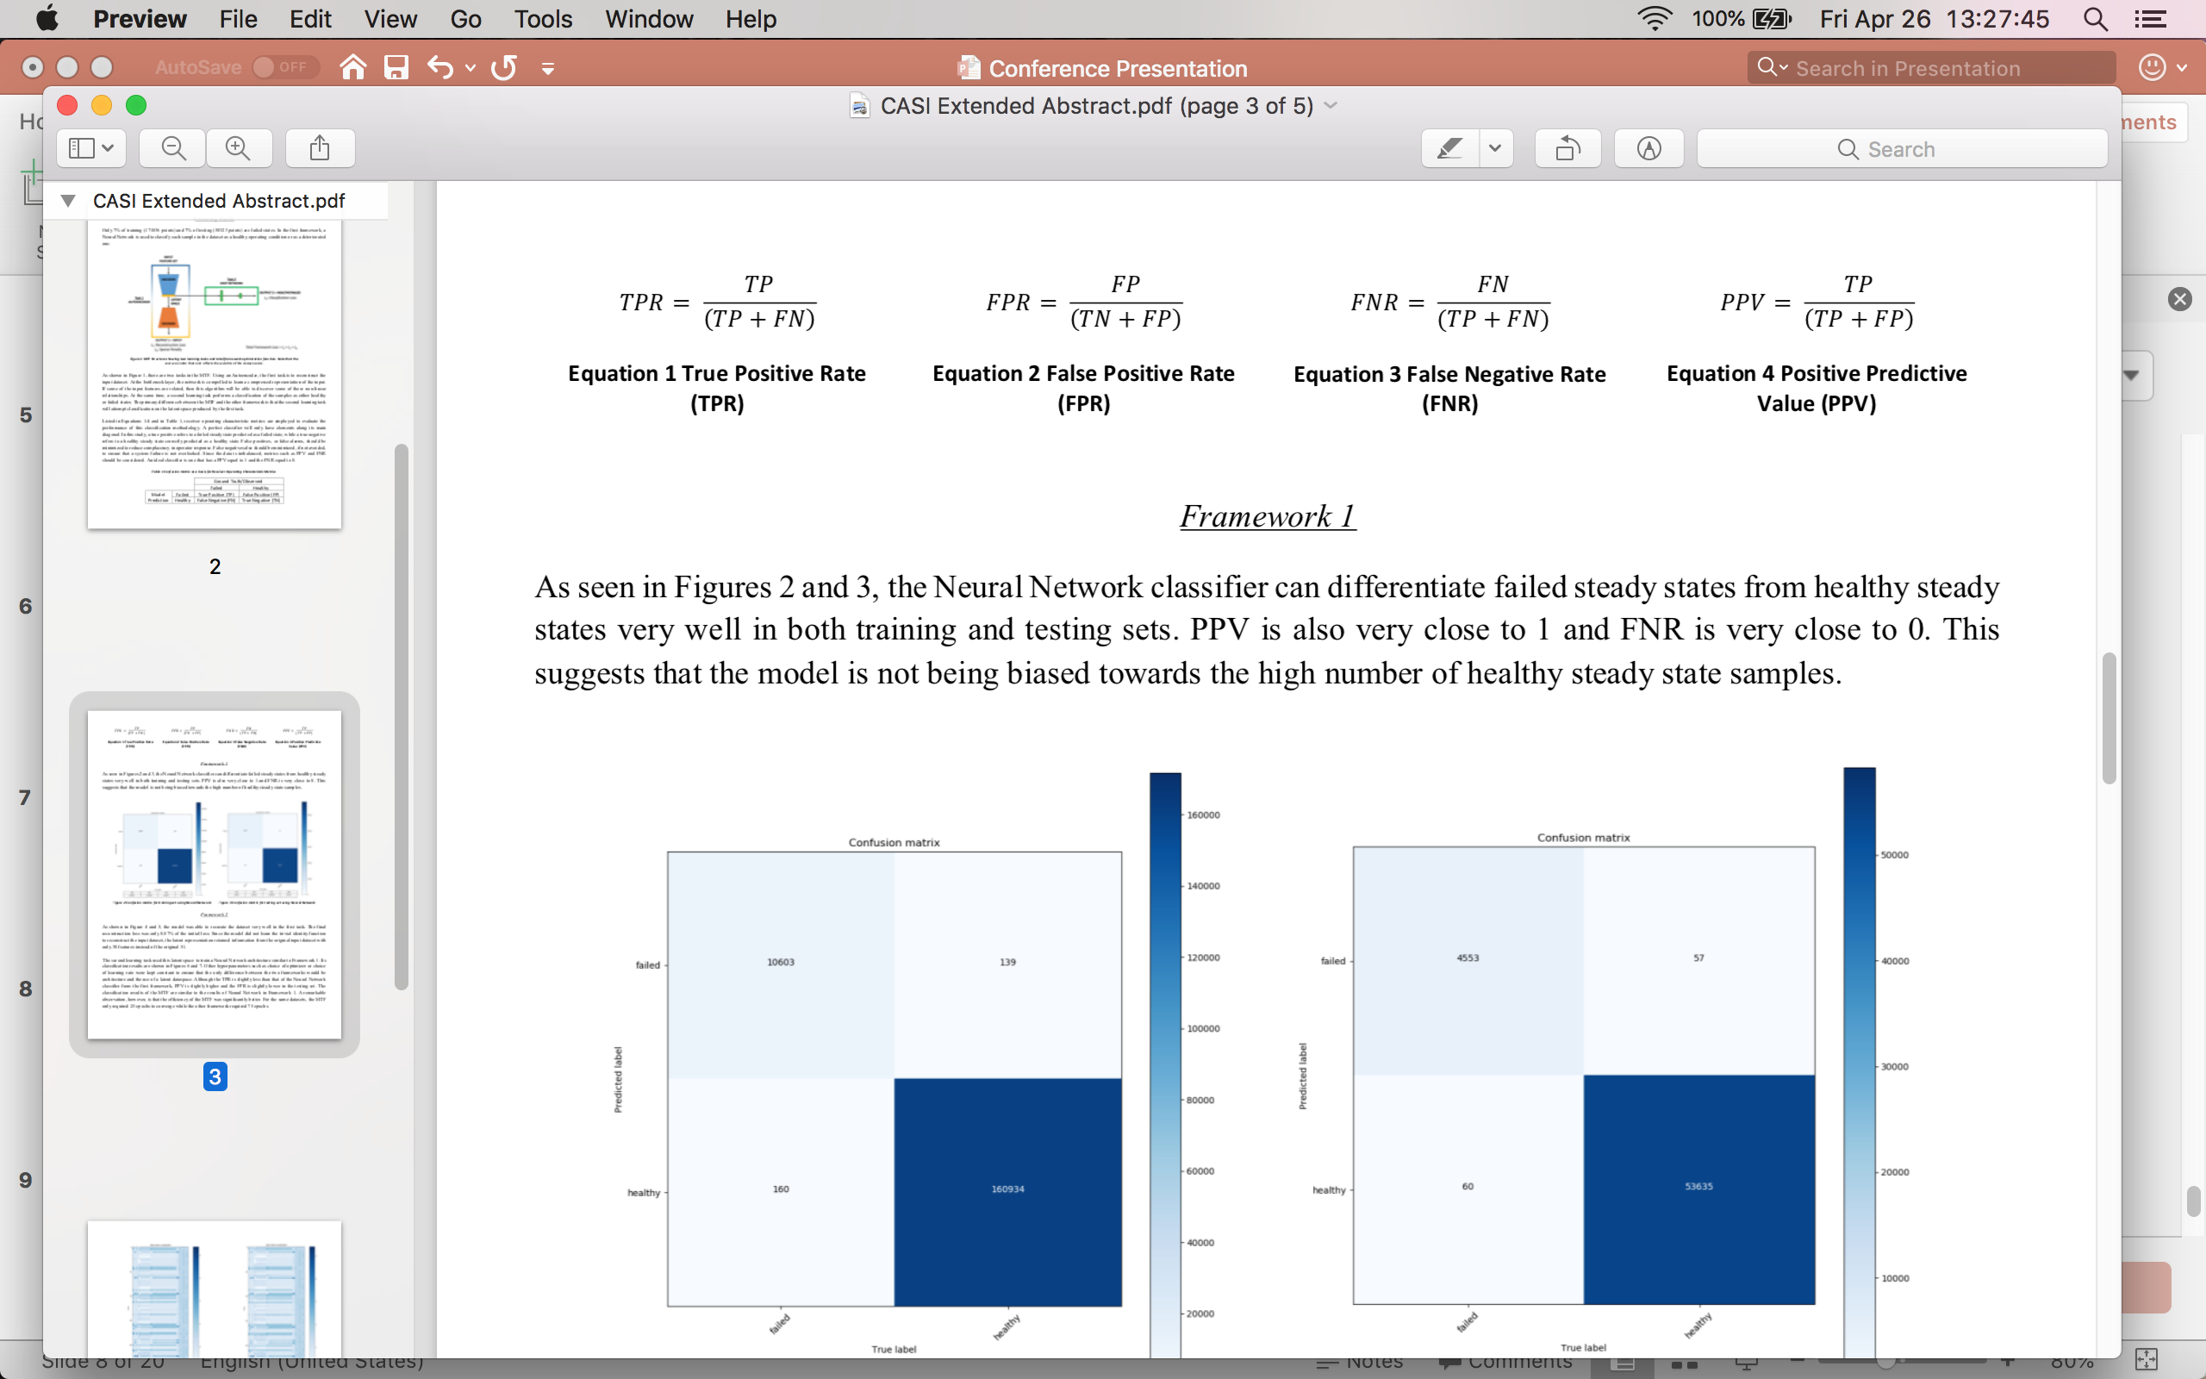
Background – Confusion Matrix*
* for a binary classifier
 |  | True Label
 |  | Failed | Healthy
Predicted Label | Failed | True Positive (TP) | False Positive (FP)
 | Healthy | False Negative (FN) | True Negative (TN)
When it's actually a failed point, how often does it predict a failure?
When the data points are healthy system states, how often is it misclassified as failed?
When the data points are failed system states, how often is it misclassified as healthy?
When it predicts a failure, how often is it correct?
Notes:
A confusion matrix is a table that is often used to describe the performance of a classification model.
-if TN is really high, as in our case where we have a very high number of healthy points, some metrics will be brought close to 0 like FPR. This is misleading because for some of these metrics, if they are close to 0, it indicates a good model. But when the data is imbalanced, this is not completely true.
-This is why PPV and FNR are god metrics to use as they don’t use the TN value.
-In our evaluation scheme, a good classifier has both the TPR and PPV close to1 and FPR and FNR close to 0.
As you can tell by the formulas of these rates, if TN is really high (as in our case where we have a large number of healthy points), then the FPR is probably much smaller. Precision is not affected by a large number of negative samples because it measure s the number of TP out of the samples predicted as positive (show confusion matric overlapping). Similarly, FNR also does not deal with TN values. These two metrics are very useful for our purposes in evaluating performance.
ROC is a probability curve and AUC represents degree or measure of separability. It tells how much model is capable of distinguishing between classes. Higher the AUC, better the model is at predicting 0s as 0s and 1s as 1s. Or in our case properly distinguishing failure events in a dataset. However, this is most useful as an evaluation scheme when both classes have equal weight. The FPR rate will probably always be small, leaving us the TPR rate to make a good decision. But just because TPR rate is high, doesn’t mean it’s a good classifier! This is where Precision and FNR come in handy.
TP
These are cases in which we predicted a failure, and the data point is a failure point.
TN
We predicted a healthy point, and the datum is a healthy point.
FP
We predicted a failure condition, but it is in fact a healthy point (think of as a false alarm).
FN
We predicted a healthy point, but it is actually a failure condition!

Slide 11
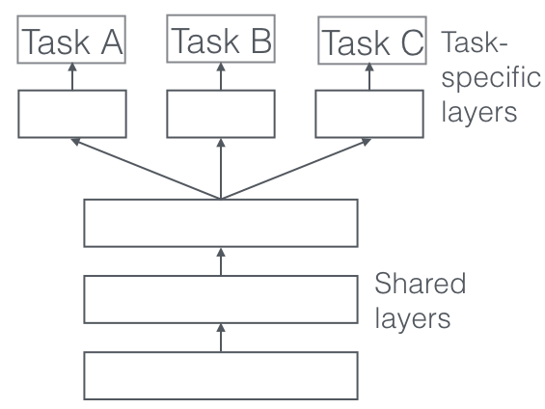
Multi-task learning
Regularization
Benefits:
Representation bias
A
B
Feature selection
Solution Spaces
Notes:
Multitasking usually has a negative connotation – say a person who tries to do a lot of things but doesn’t succeed in anything. Multi task learning however, is quite normal for humans. Let’s take this image on the far left here. (IMAGE SEGMENTATION) We can immediately segment the image and identify several objects like cars lined up, the road, the sidewalk, buildings, trees and other things. In this image a pavement is actually very similar to a car or even a building. How? (BASIC PARTS: LINES, CURVES, BASIC SHAPES) Well each object can be deconstructed into its simplest parts. It’s made up of lines, basic shapes and some curves. Eventually, if we put these lines, curves and basic shapes together we can identify the actual object be it a sidewalk, a car or a building. For us humans, this is a very natural, quick process. In fact, this basic information we use to understand that oh this object is a car can be transferred to identify other objects such as all these right here. This is shown here between faces and cars.
Can you image having to restart from the very beginning each process to identify each object? Like oh okay heres a line, that’s a trapezoid ok that’s a car. And then for the next object: that’s a edge, that’s a shape, or here’s a building!
If we were to make a machine learning model do this, that would be one way of segmenting the image. A different model would be constructed for each item here. But what if we could train our model to do all of it at once like how we process the image naturally? We could leverage common information from each task to help learn related tasks better. This is known as multi task learning.
If we had machine learning do this example, we would call it multi task learning. There are some benefits to this approach.
The more related tasks we are learning simultaneously, the more our model has to find a representation that captures all of the tasks and the less is our chance of overfitting on our original task.
when you train your model over an intersection of several tasks you push your learning algorithm to find a solution on a smaller area of representations on the intersection rather on a large area of a single task. It leads to faster and better convergence. It uses the domain information contained in the training signals of related tasks as an inductive bias
if one feature is important for more than just one task, then most probably this feature is indeed very important and representative for your data
- In summary: what is learned for each task can help other tasks be learned better
The term “multitasking” usually has a negative connotation — a person who tries to do a lot of things and doesn’t succeed in anything of that is the best example. But here I want to talk about a bit different “multitasking”. Multitask learning is normal for humans (but maybe not multitasking haha)
In this image, my vision system can identify more than just my two cats, it can segment them from the image, estimate their moods, see the colour of their fur, and a lot of other significant details that help enrich my understanding of the image. Some of the information that I used to identify my cats in the image can help me process other details like the type of cat they are.
If we had machine learning do this example, we would call it multi task learning. There are some benefits to this approach.
The more related tasks we are learning simultaneously, the more our model has to find a representation that captures all of the tasks and the less is our chance of overfitting on our original task.
when you train your model over an intersection of several tasks you push your learning algorithm to find a solution on a smaller area of representations on the intersection rather on a large area of a single task. It leads to faster and better convergence. It uses the domain information contained in the training signals of related tasks as an inductive bias
if one feature is important for more than just one task, then most probably this feature is indeed very important and representative for your data
- In summary: what is learned for each task can help other tasks be learned better
Typically, we train single model for some task. We then fine-tune and tweak these models until their performance no longer increases. While we can generally achieve acceptable performance this way, by being laser-focused on our single task, we ignore information that might help us do even better on the metric we care about. Specifically, this information comes from the training signals of related tasks. By sharing representations between related tasks, we can enable our model to generalize better on our original task. This approach is called Multi-Task Learning (MTL) and will be the topic of this blog post.
MTL improves generalization by leveraging the domain-specific information contained in the training signals of related tasks - Rich Caruana
We can motivate multi-task learning in different ways: Biologically, we can see multi-task learning as being inspired by human learning. If a task is very noisy or data is limited and high-dimensional, it can be difficult for a model to differentiate between relevant and irrelevant features. MTL can help the model focus its attention on those features that actually matter as other tasks will provide additional evidence for the relevance or irrelevance of those features. Attention focusing
As different tasks have different noise patterns, a model that learns two tasks simultaneously is able to learn a more general representation. Learning just task Abears the risk of overfitting to task A, while learning Aand B jointly enables the model to obtain a better representation F through averaging the noise patterns. Implicit data augmentation
Finally, MTL acts as a regularizer by introducing an inductive bias. As such, it reduces the risk of overfitting as well as the Rademacher complexity of the model, i.e. its ability to fit random noise. Representation bias: when you train your model over an intersection of several tasks you push your learning algorithm to find a solution on a smaller area of representations on the intersection rather on a large area of a single task. It leads to faster and better convergence. Regularization
Feature selection double check:
However, we still do not have a good notion of when two tasks should be considered similar or related. Caruana (1998) defines two tasks to be similar if they use the same features to make a decision. Baxter (2000) argues only theoretically that related tasks share a common optimal hypothesis class, i.e. have the same inductive bias. ^{[54]}propose that two tasks are F-related if the data for both tasks can be generated from a fixed probability distribution using a set of transformations F. While this allows to reason over tasks where different sensors collect data for the same classification problem, e.g. object recognition with data from cameras with different angles and lighting conditions, it is not applicable to tasks that do not deal with the same problem. Xue et al. (2007) finally argue that two tasks are similar if their classification boundaries, i.e. parameter vectors are close.
When I learn a new language, especially a related one, I use my knowledge of languages I already speak to make shortcuts. The process works the other way too - learning a new language can help you understand and speak your own better.
Our brains learn to do multiple different tasks at the same time - we have the same brain architecture whether we are translating English to German or English to French. If we were to use a Machine Learning algorithm to do both of these tasks, we might call that ‘multi-task’ learning.
Rich Curanana - Multitask Learning is an approach to inductive transfer that improves generalization by using the domain information contained in the training signals of related tasks as an inductive bias. It does this by learning tasks in parallel while using a shared representation; what is learned for each task can help other tasks be learned better.[

Slide 12
Motivation and Introduction
Background
Neural Network
Auto-encoders
Metrics for Evaluation
Multi-task Learning
Experimental Setup – Models
Data Distribution
Classification Results
Discriminative Analysis
Summary and Future Steps

Slide 13
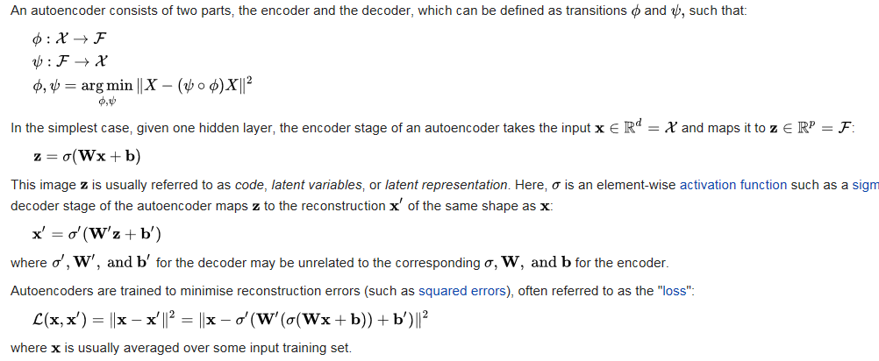
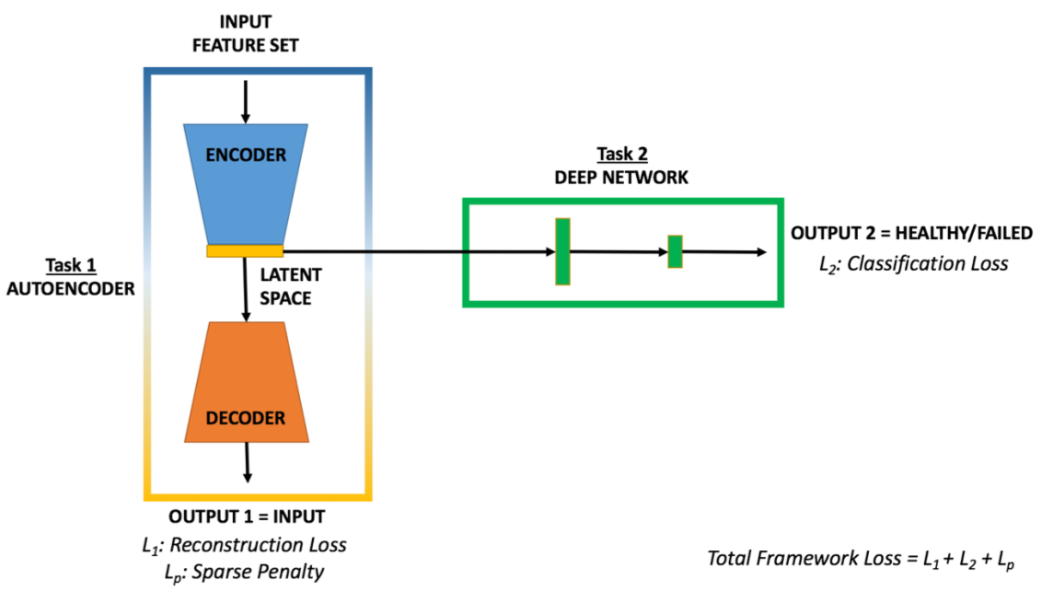
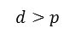
Experimental Setup - Models
Baseline Framework (F1)
INPUT FEATURE SET
OUTPUT = HEALTHY/FAILED
L_{F1}= Classification Loss
In this work, we compare the new proposed machine learning model (MTF) to a baseline framework (F1)
Both tasks in the MTF are learned simultaneously during training
Multi-task Framework
(MTF)
$$d>p$$
Notes:
As I mentioned earlier, we would like to propose the Multi-task framework, or MTF for short, as a new model to help distinguish between healthy and failed operating states for an engine. The original framework, or F1, will be used as a baseline to see how MTF performs in comparison.
F1 is just a simple neural network where the input dataset is fed in one end and classification results are given at the other end.
MTF has two tasks. The first task to recreate the input. For this, we are using a sparse autoencoder to provide us a roboust and sparse representation of the dataset. The second task is the same as F1, that is to classify the incoming dataset as healthy or failed points. The only difference is that the input dataset is not the original datamatrix as in F1, but rather the compressed latent space developed by the autoencoder.
The losses from both these tasks are grouped so that all tasks can be learned together. The shared layers are in blue as part of the encoding section in the autoencoder. We assume that the information / feature set used to create the latent space is in common to the decoder and to the classification task of the framework.
Thus, we are able to reduce the number of dimensions used in classification and train with multiple loss functions grouped as a single objective.

Slide 14
Data Distribution
Complete dataset
93% healthy points
7% failed points
Training Set
75% of healthy
25% of healthy
Testing Set
70% of failed
30% of failed
7% failed points
7% failed points
93% healthy points
93% healthy points

Slide 15
Classification Results
 | Classification Accuracy
 | TRAINING |  |  |  | TESTING
 | TPR | FPR | PPV | FNR | TPR | FPR | PPV | FNR
F1 | 0.9851 | 0.0009 | 0.9871 | 0.0149 | 0.9870 | 0.0011 | 0.9876 | 0.0130
MTF | 0.9712 | 0.0011 | 0.9833 | 0.0288 | 0.9705 | 0.0008 | 0.9905 | 0.0295
 |  | True Label
 |  | Failed | Healthy
Predicted Label | Failed | True Positive (TP) | False Positive (FP)
 | Healthy | False Negative (FN) | True Negative (TN)
Criteria:
TPR close to 1, the better
PPV close to 1, the better
FPR close to 0, the better
FNR close to 0, the better

Slide 16
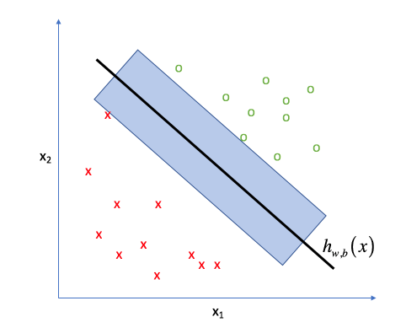
Discriminative Analysis
 | Support Vector Machine Accuracy (Linear Separability)
 | TRAINING |  |  |  | TESTING
 | TPR | FPR | PPV | FNR | TPR | FPR | PPV | FNR
Original dataset | 1.0000 | 0.0475 | 0.5844 | 0.0000 | 0.9998 | 0.0482 | 0.6406 | 0.0002
Latent space | 0.9999 | 0.0249 | 0.7287 | 0.0001 | 0.9993 | 0.0249 | 0.8379 | 0.0007
hyperplane
margin
Linear separability is seen as a feature space quality measure
A training dataset whose classes can be separated easily, will help to build a better classification model
Notes:
In this part of the analysis, we investigate to see if there was any significant information loss caused by the act of compressing the original dataset to produce the latent space. We’ve employed SVM classifiers to give us a quanititative estimate on this property of linear separability. If a dataset is more linearly separable its easier to distinguish between healthy and failed points in the dataspace as shown here. If a dataspace is harder to separate, as you can imagine it would be harder to make the cut to separate the data into homogenous groups. The latent space should at least have the same values of the original dataset if it was a good compression. If there was significant information loss, then these results would be poor. We noticed a very large gain in PPV from the latent set, with all other parameters staying consistent. This means that when the latent space is used to predict a failure, it is more correct than if the original dataset was used because it is more linearly separable.
we employ Support Vector Machine (SVM) classifiers to analyse the linear separability of the latent space. Intuitively, a more adequate feature space performs better in SVM, which finds the best as possible linear discriminator with learning guarantees [20], [21]. This way the classification accuracy can also be seen as a feature space quality measure.
From this we can see that the TPR and FNR rates are essentially the same. That is the discriminative power is much higher and

Slide 17
Summary and Future Steps
Summary
Input recreation accuracy in MTF is high (Task 1)
Classification results of MTF compared to F1 are similar (Task 2)
Efficiency of MTF is 3 times higher than F1
Latent space is more linearly separable than the original dataset
Future Steps
Conduct an investigation on the efficiency of the model
Investigate the features engineered from the dataset and compare them to the features of the original dataset
Development of tools for in real-time/quasi-real-time model updates
Notes:
To recap:
We were able to develop a novel multi task framework to classify engine sensor data as healthy or failed using a reduced dataspace and with a model trained with multiple loss functions.
We were also able to produce experimental results using this framework and compared it to a simpler neural network.
The input recreation accuracy was very high and the classification results between the two frameworks were very similar, however MTF took only a third of the time to produce them.
The latent space generated by the sparse autoencoder was more linearly separable than the original data space.
The ultimate goal of this project is to develop a prognostic tool. This would be to build on diagnostic assessment and generate capability to predict the progression of the fault condition before failure actually occurs.
Supervised learning is powerful but still severally limited. Once a good feature representation is given this type of algorithm can work well.
This framework incorporates expert knowledge for structural and dynamic properties of the engine, and recognizes the low tolerance for false alarms and false negatives.
This paper/presentation presents a framework for equipment diagnostics, a fist but critical step towards autonomous diagnostics and prognostics, relying on a mixture of unsupervised and supervised methods.
The concept of unsupervised autonomous monitoring and diagnostics is based on unsupervised techniques. This implies having an ability to learn on-line without human intervention or supervision.
Some of the major challenges to the method of novelty detection include: ability to execute as a n autonomous agent, use of learning algorithms that don’t require human supervision, simplified setup with minimal number of parameters to be estimated in advance, flexible evolving structure that dynamically adapts to the equipment signature, minimization of false alarms and portability to a wide variety of systems.

Slide 18

Thank you!
With special thanks to:

Slide 19

Support Vector Machine
Transforms feature space to a space where it can construct linear boundaries or decision boundaries to separate classes
A hyperplane is a subspace which consists of one less dimension than the feature space
hyperplane
margin
This is also seen as a feature space quality measure
A training dataset whose classes can be separated easily, will help to build a better classification model
Notes:
As with regression, and model-based classification in general, our goal is to determine some establishing decision boundary which is capable of separating the data into homogenous groups (ie. every example on the same of a decision boundary has the same label) using the features provided.
For the case where we have two features, our decision boundary happens to be a line. More generally, we'll refer to this boundary as a hyperplane- a subspace which consists of one less dimension than your feature space. Thus, if we were to draw a decision boundary for a dataset with three features, our boundary would be a plane.
we'd like to construct a hyperplane that is consistent with the data while committing the least amount to the specific training dataset - models that depend too much on the training data are prone to overfitting. We want to have the most space possible between the decision boundary and the data points on each side of the line in order to increase the total confidence in our predictions.
In the world of SVMs, this "space" is called the margin (as visualized below). By maximizing the size of this margin, we can build an optimal classifier.

Slide 20
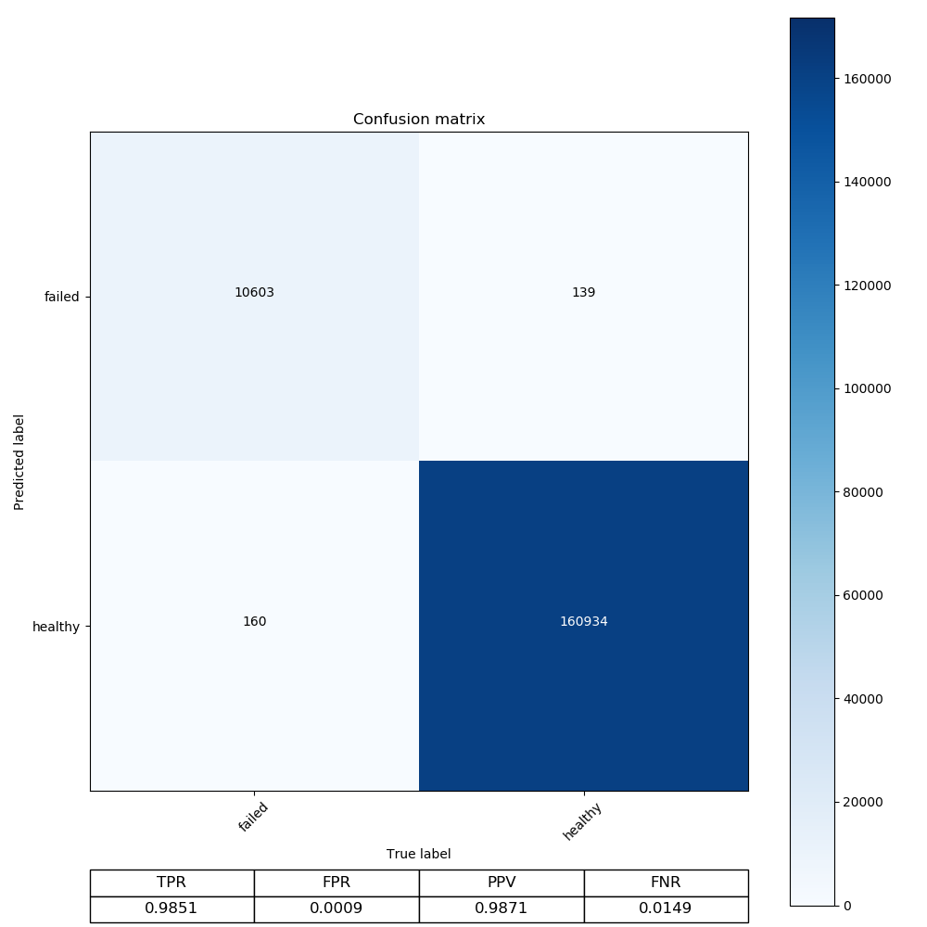

F1
MTF
Training
Notes:
Classification Results F1 vs MTF Training
The results between the two frameworks in training are very similar.

Slide 21


F1
MTF
Testing
Notes:
Classification Results – F1 vs MTF Testing
The results between the two frameworks in testing are also very similar.

Slide 22
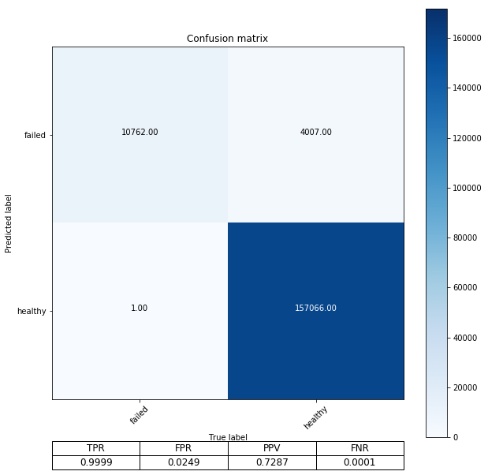
Actual
Model
Notes:
SVM – F1 vs MTF Training
Linear separability!

Slide 23
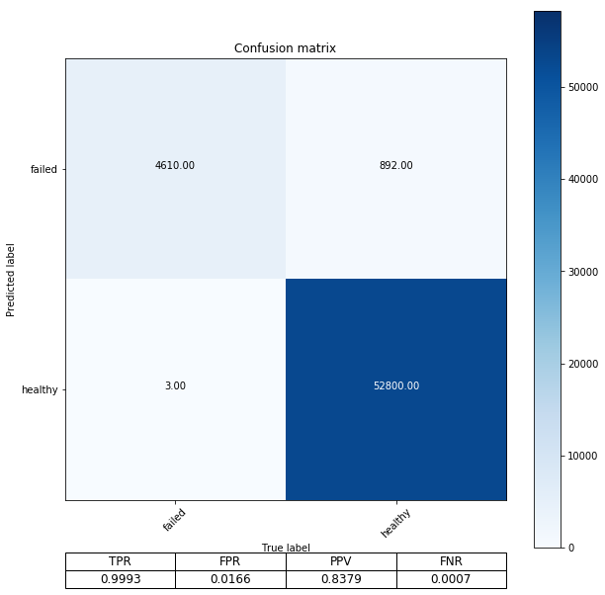
Actual
Model
Notes:
SVM – F1 vs MTF testing

Slide 24
Literature Review
IJPRAI
Several classification methods and anomaly detection methods were implemented to distinguish between normal healthy operating conditions and deteriorated conditions on a turbocharger system
The leader clustering algorithm was used to reduce the amount of data to train and develop the models. In this work, we expanded our analysis of the dataset by seeking out ways to reduce the dimensions of the data instead of reducing the data itself.
Several previous works have used autoencoders for feature learning or for dimensionality reduction since the number of neurons in the hidden layer is smaller than the dimension of the input. In fact, many studies [26, 27] showed that an autoencoder with nonlinear characteristic is more efficient than linear dimensionality reduction techniques such as Principal Component Analysis (PCA) when the input data have a nonlinear or a sparse structure. Overall, this provides significant benefits for the inspection task: the computational time and the required memory for storage. And even better, removing the redundant information by maximizing the covariance.
Hinton G, Salakhutdinov R. Reducing the Dimensionality of Data with Neural Networks. Science. 2006; 313(5786):504–507. https://doi.org/10.1126/science.1127647 PMID: 16873662
Notes:
Samples of total objects were built using the leader clustering algorithm. In this method, representative objects (leaders) are chosen to ensure that for every object in the dataset there is at least one leader sufficiently close in distance given a threshold (given a similarity metric). The algorithm can produce a sample that is structurally compatible with the whole dataset, thus ensuring that odd or outlying elements will not be left unaccounted in the sample, as may occur with random sampling. Here the dissimilarity measure used was Euclidean distance.

